Slide 1
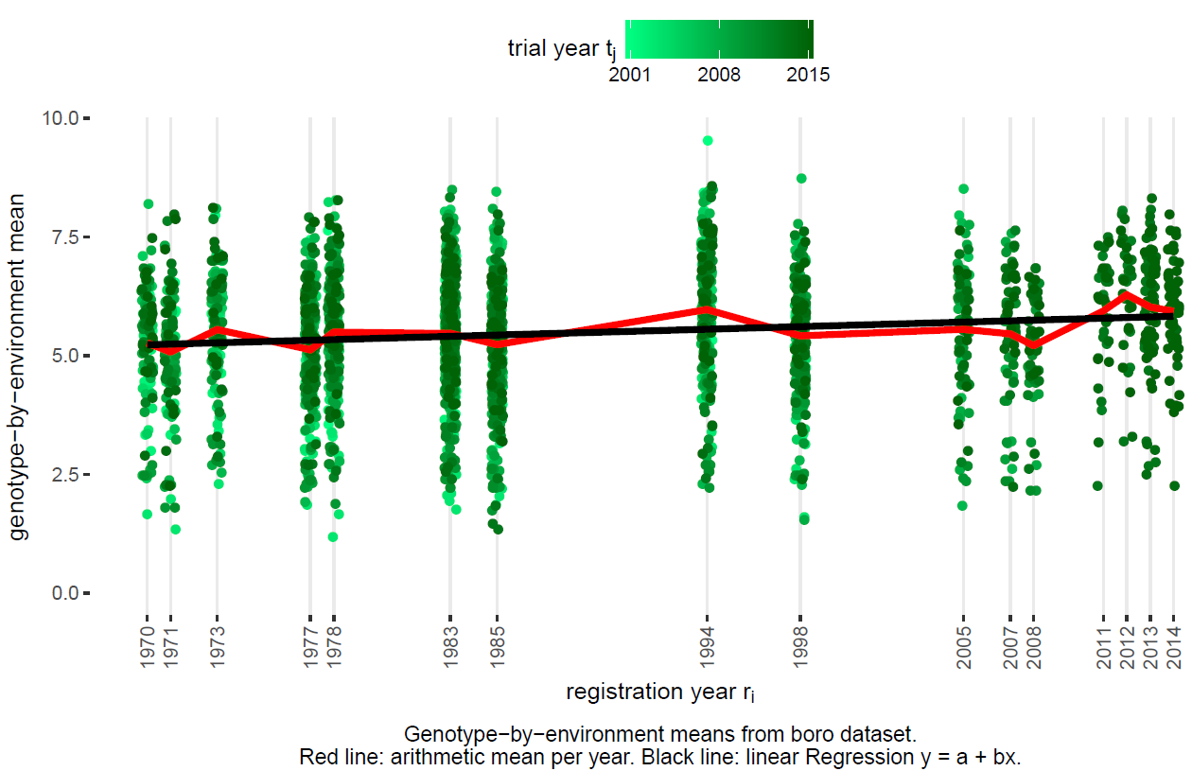
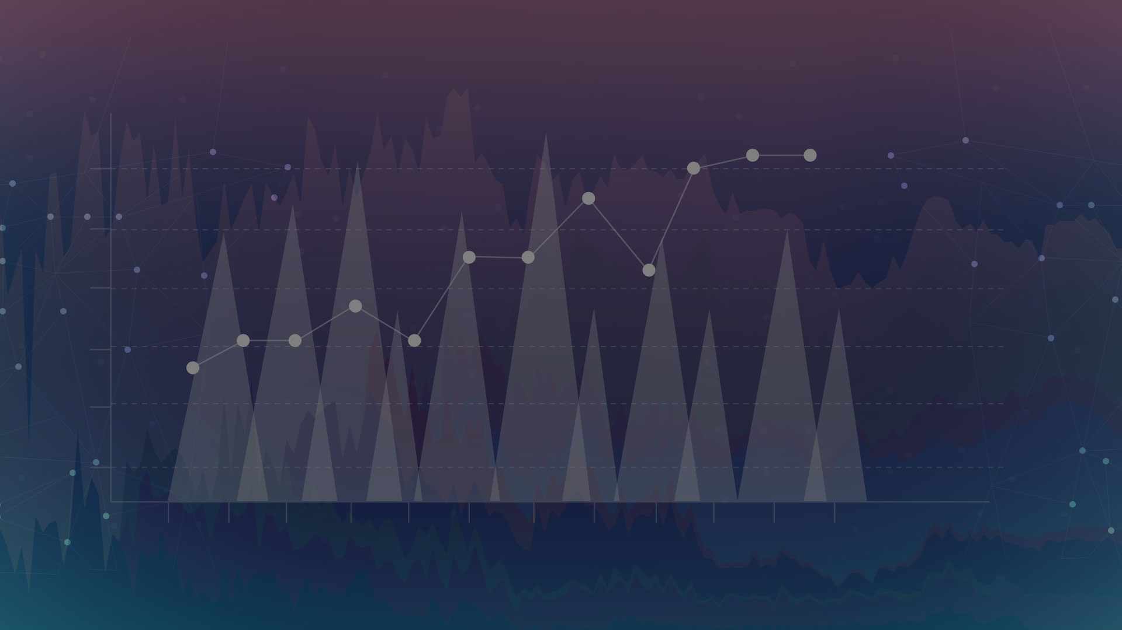
Implementation of
genetic gain assessment
using the BRRI data

Slide 2

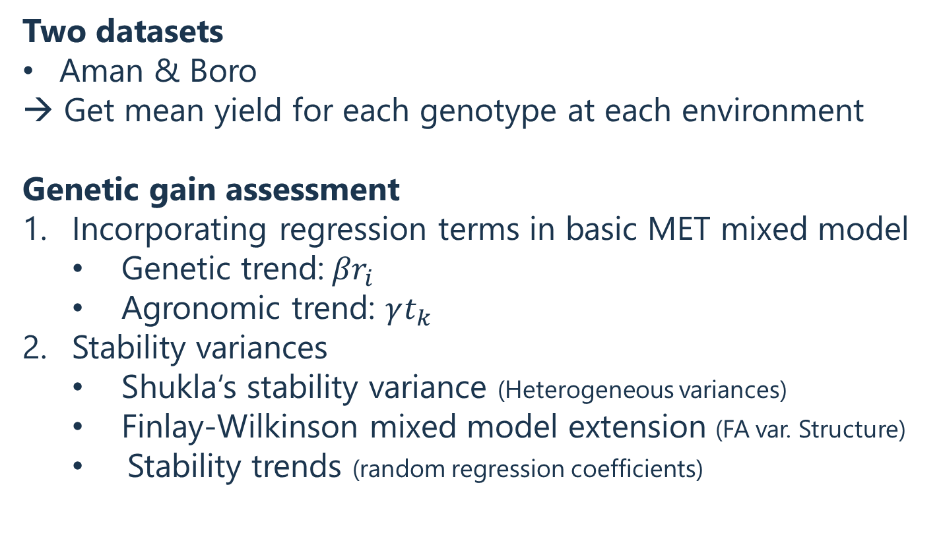
Overview
Two datasets
Aman & Boro
→ Get mean yield for each genotype at each environment
Genetic gain assessment
Incorporating regression terms in basic MET mixed model
Genetic trend:${βr}_{i}$
Agronomic trend: $γt_{k}$
Stability variances
Shukla‘s stability variance (Heterogeneous variances)
Finlay-Wilkinson mixed model extension (FA var. Structure)
Stability trends (random regression coefficients)

Slide 3
Two datasets
Aman & Boro
Data
R-Code:
„01 import“

Slide 4
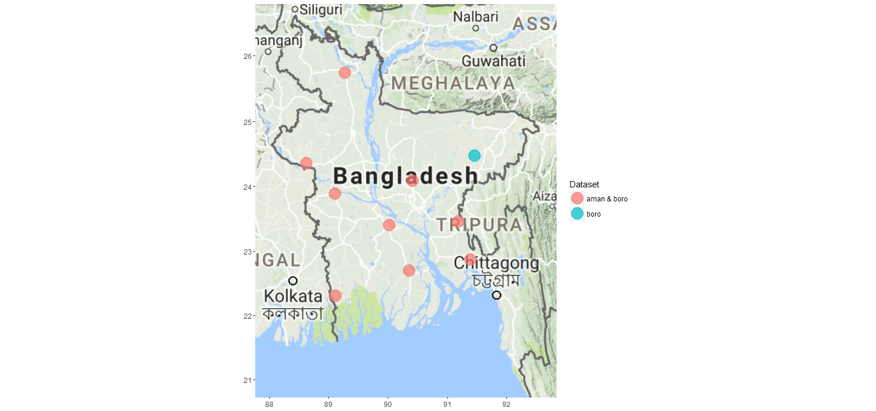
Data

Slide 5
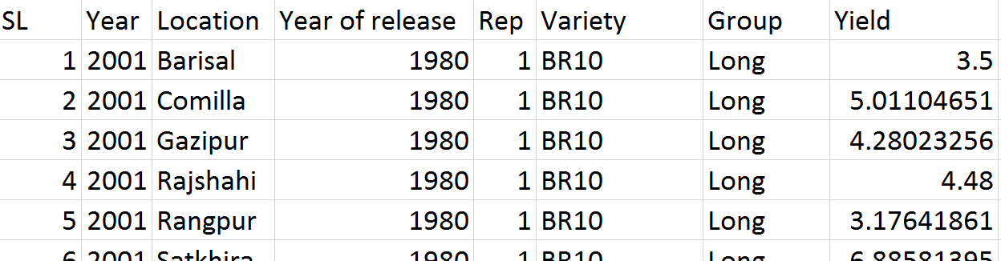
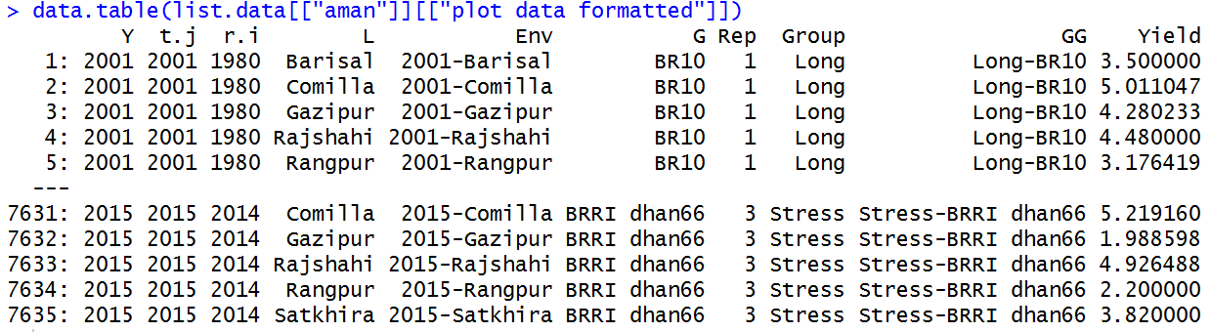
Data
R-Code:
„01 import“
Original
Formatted
Numeric
New columns

Slide 6
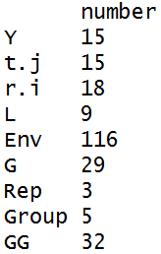
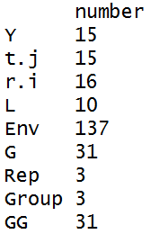
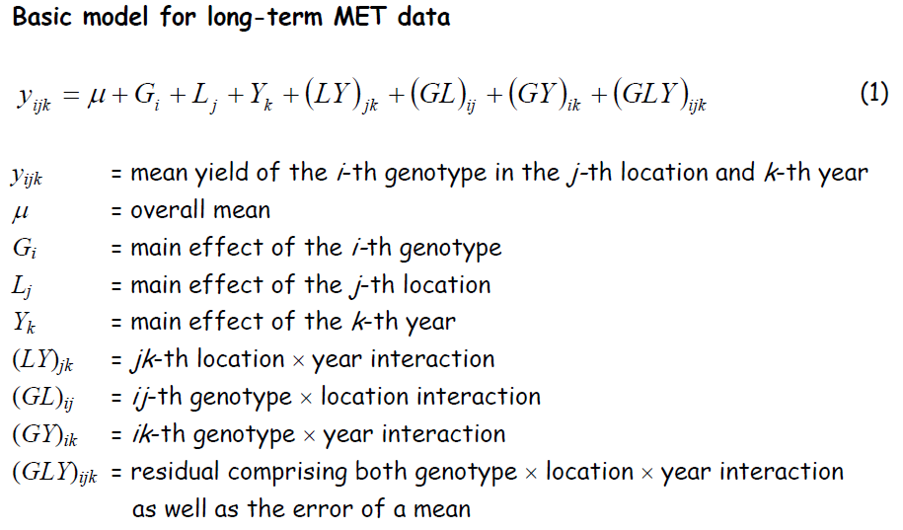
Data
R-Code:
„01 import“
Table: Number of unique entries per column
Aman | Boro

Slide 7
Two datasets
Aman & Boro
→ Get mean yield for each genotype at each environment
GxE means
R-Code:
„02 GxE means“

Slide 8
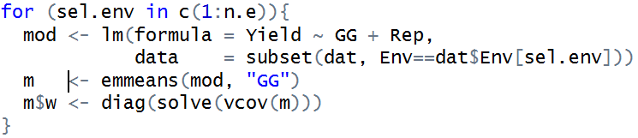
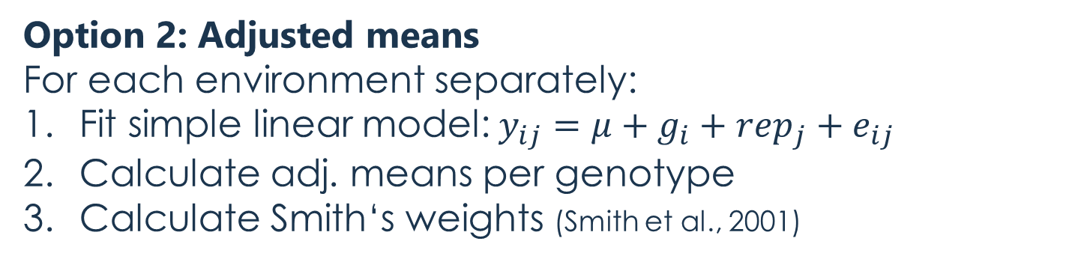
GxE means
R-Code:
„02 GxE means“
Goal: Obtain yield per genotype and environment averaged over replicates
Option 1: Arithmetic means
Option 2: Adjusted means
For each environment separately:
Fit simple linear model:$y_{ij}=μ+g_{i}+rep_{j}+e_{ij}$
Calculate adj. means per genotype
Calculate Smith‘s weights (Smith et al., 2001)

Slide 9
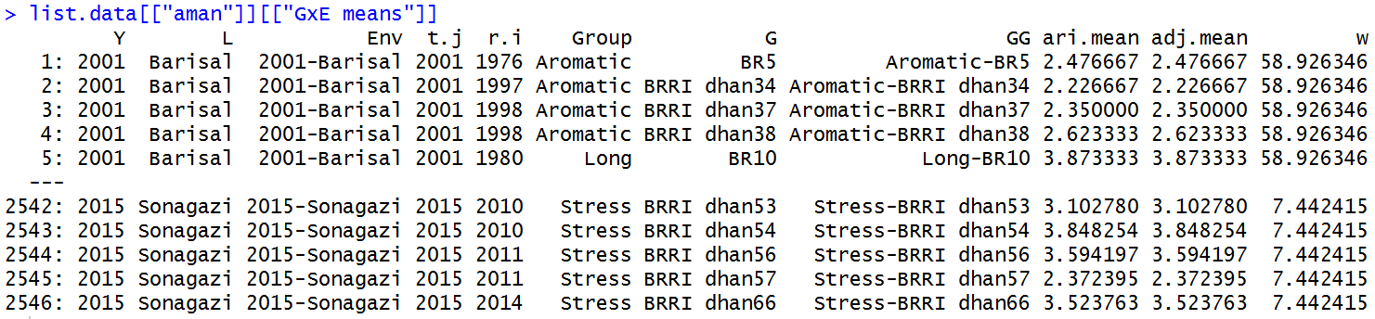
GxE means
R-Code:
„02 GxE means“
3 additional columns
number of lines decreased to 1/3

Slide 10
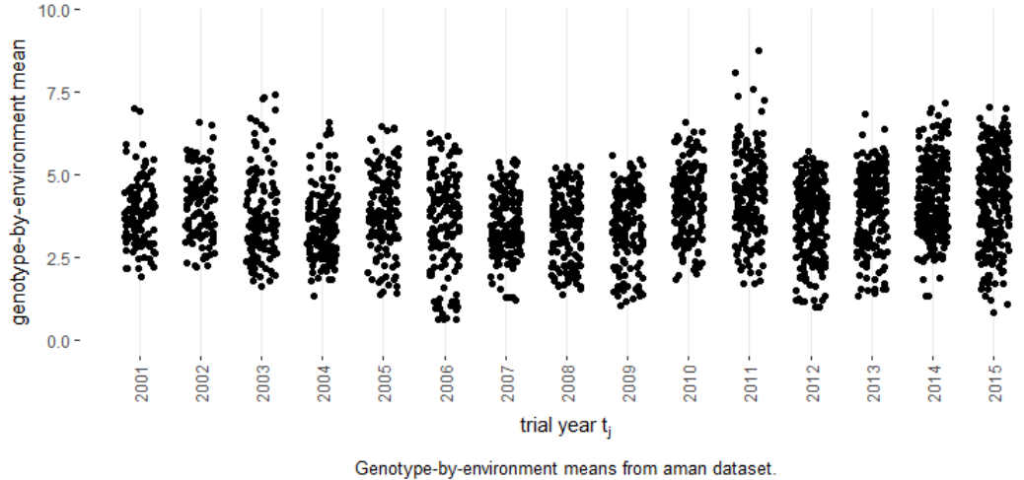
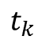
GxE means
R-Code:
„02b plot GxE means“
$$t_{k}$$

Slide 11
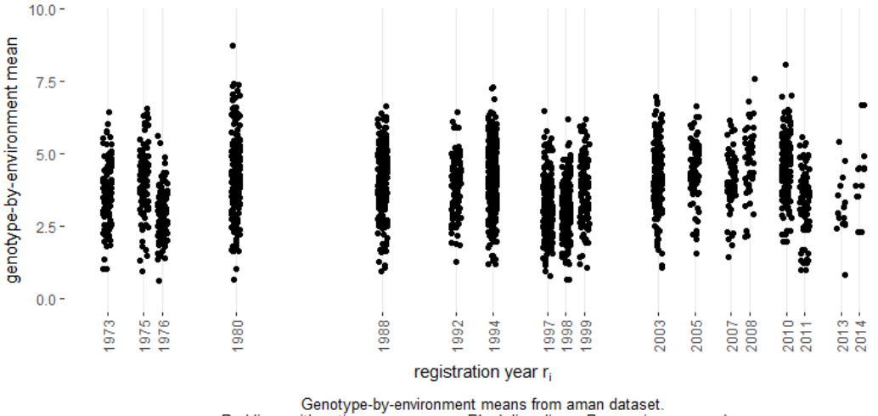
GxE means
R-Code:
„02b plot GxE means“

Slide 12
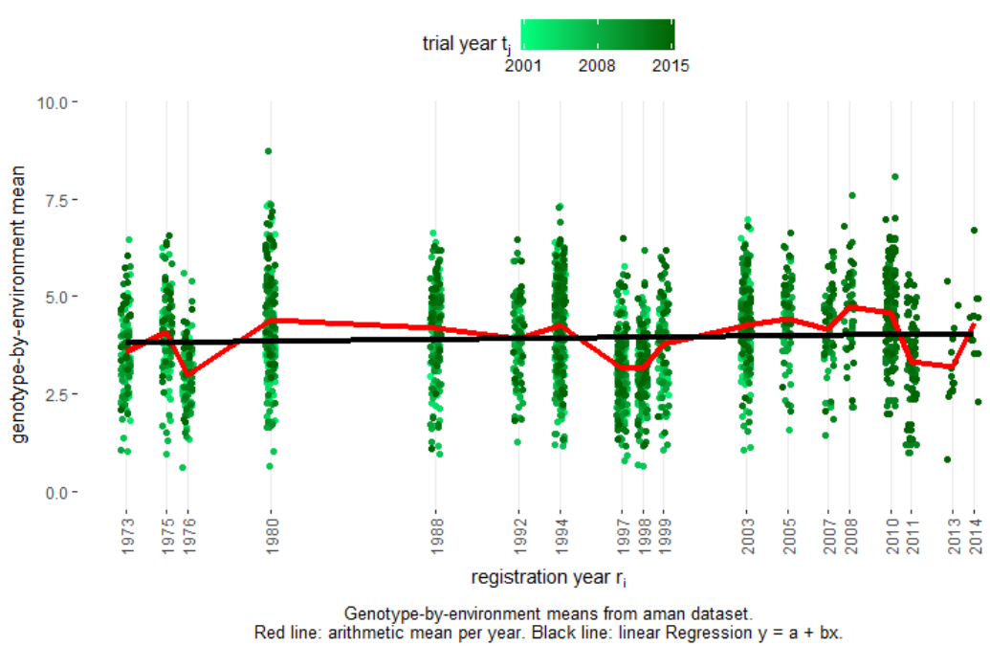
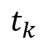
GxE means
R-Code:
„02b plot GxE means“
$$t_{k}$$

Slide 13
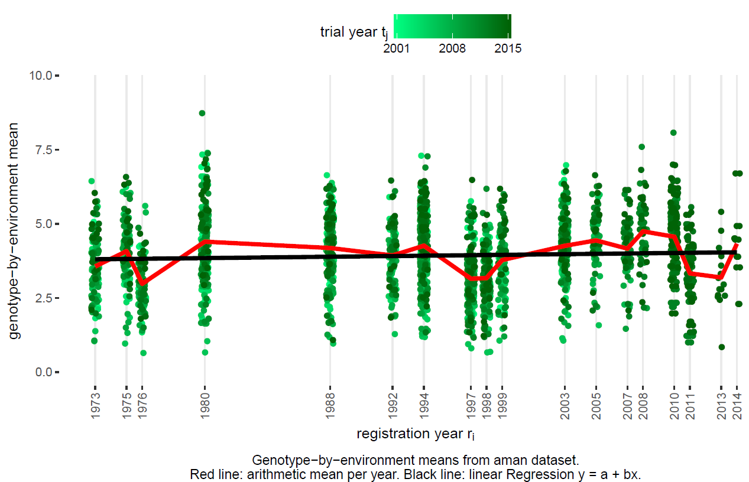
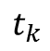
GxE means
R-Code:
„02b plot GxE means“
Aman dataset
$$t_{k}$$

Slide 14
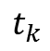
GxE means
R-Code:
„02b plot GxE means“
Boro dataset
$$t_{k}$$

Slide 15
Genetic gain assessment
R-Code:
„02 genetic gain“
Incorporating regression terms in basic MET mixed model

Slide 16
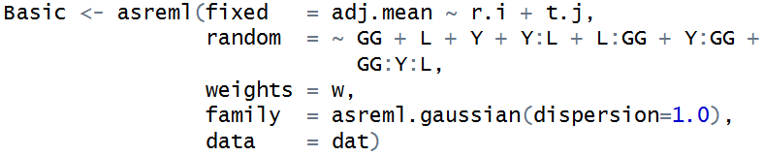
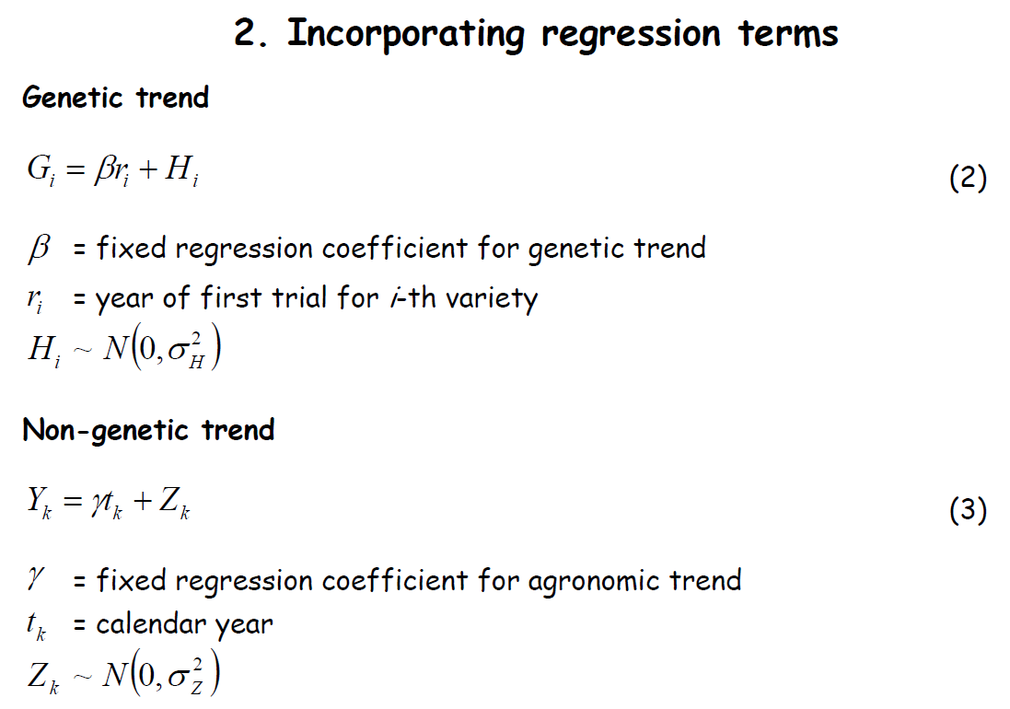
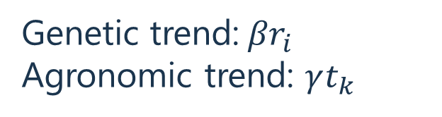
Genetic gain assessment
R-Code:
„02 genetic gain“
Genetic trend:${βr}_{i}$
Agronomic trend: $γt_{k}$

Slide 17
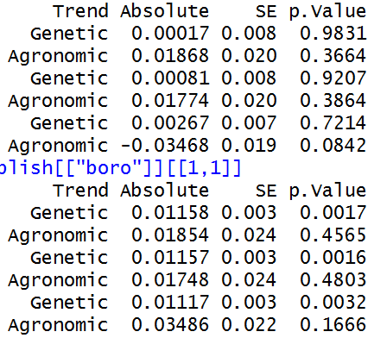
Genetic gain assessment
R-Code:
„02 genetic gain“
Genetic trend:${βr}_{i}$
Agronomic trend: $γt_{k}$
Solutions and tests for trends
aman
boro

Slide 18
Genetic gain assessment
R-Code:
„02 genetic gain“
Incorporating regression terms in basic MET mixed model
Stability variances
Shukla‘s stability variance (Heterogeneous variances)

Slide 19
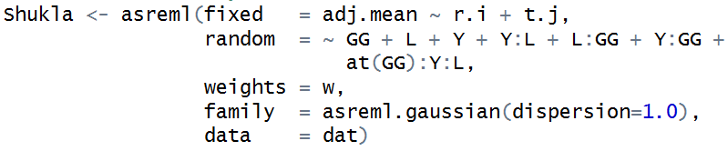
Genetic gain assessment
R-Code:
„02 genetic gain“
Genetic trend:${βr}_{i}$
Agronomic trend: $γt_{k}$
Solutions and tests for trends
aman
boro

Slide 20
Genetic gain assessment
R-Code:
„02 genetic gain“
Incorporating regression terms in basic MET mixed model
Stability variances
Shukla‘s stability variance (Heterogeneous variances)
Finlay-Wilkinson mixed model extension (FA var. Structure)

Slide 21
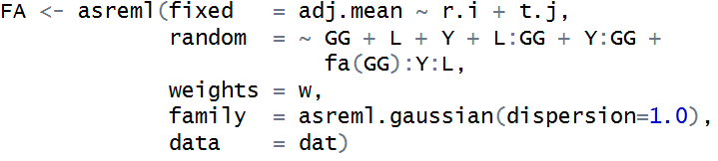
Genetic gain assessment
R-Code:
„02 genetic gain“
Genetic trend:${βr}_{i}$
Agronomic trend: $γt_{k}$
Solutions and tests for trends
aman
boro

Slide 22

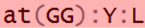
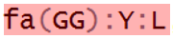
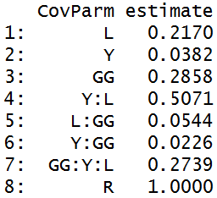
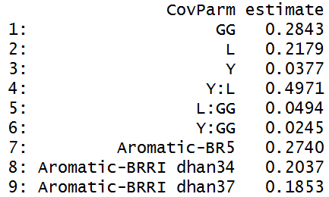
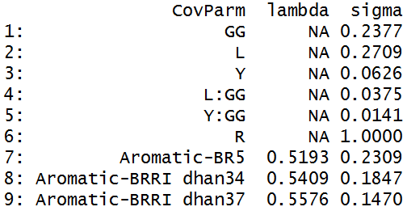
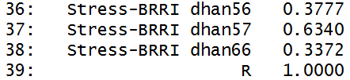
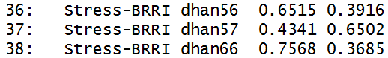
Genetic gain assessment
R-Code:
„02 genetic gain“
Basic
Shukla
FA
…
…

Slide 23
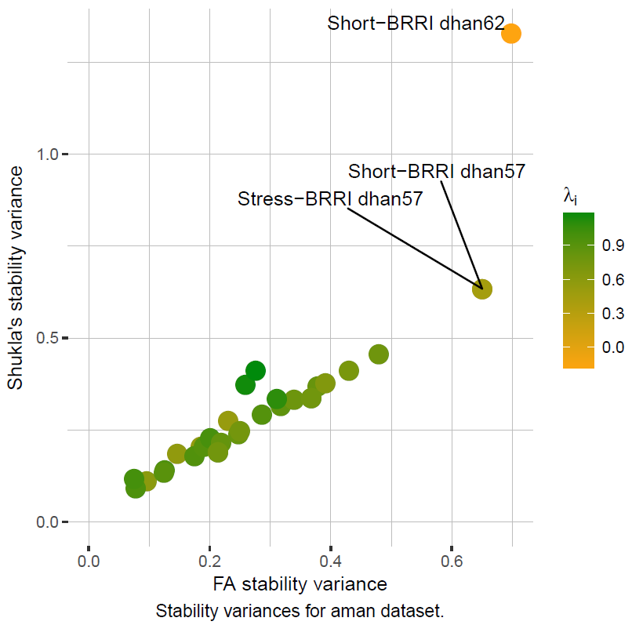
Genetic gain assessment
R-Code:
„02 genetic gain“

Slide 24
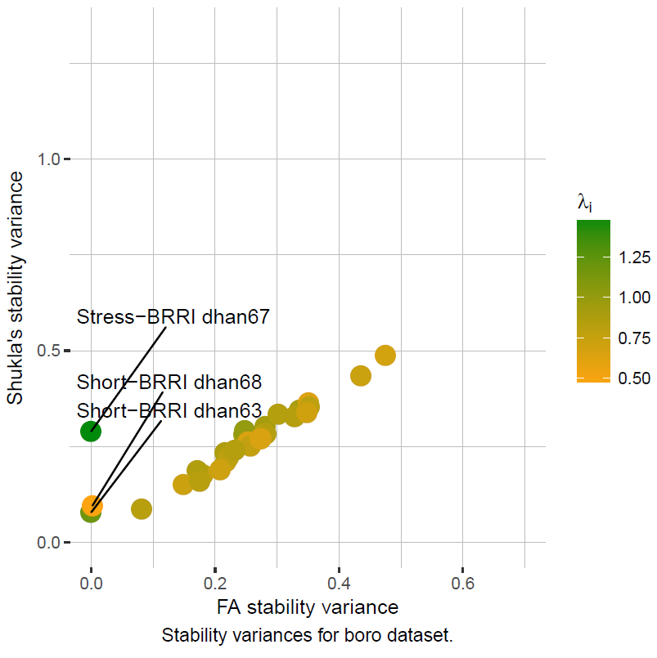
Genetic gain assessment
R-Code:
„02 genetic gain“

Slide 25
Genetic gain assessment
R-Code:
„02 genetic gain“
Incorporating regression terms in basic MET mixed model
Stability variances
Shukla‘s stability variance (heterogeneous variances)
Finlay-Wilkinson mixed model extension (FA var. structure)
Stability trends (random regression coefficients)

Slide 26
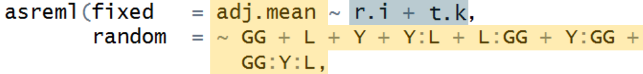
Genetic gain assessment
R-Code:
„02 genetic gain“
Term in Basic model
Potentialadditional term
Investigate all possible combinations
Not estimable, because each G:L appears only once per trial year tk

Slide 27
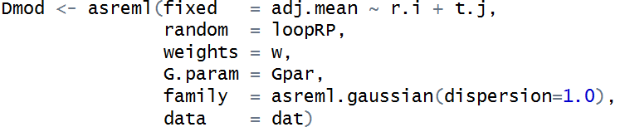
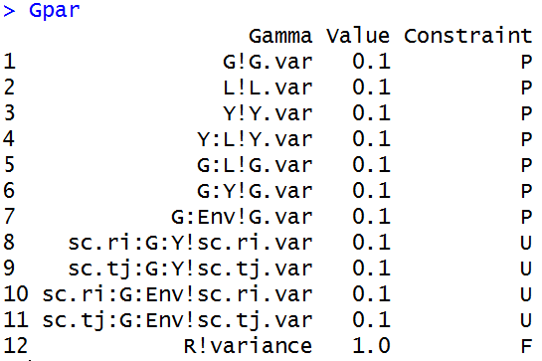
Genetic gain assessment
R-Code:
„02 genetic gain“
Loop through all models!

Slide 28
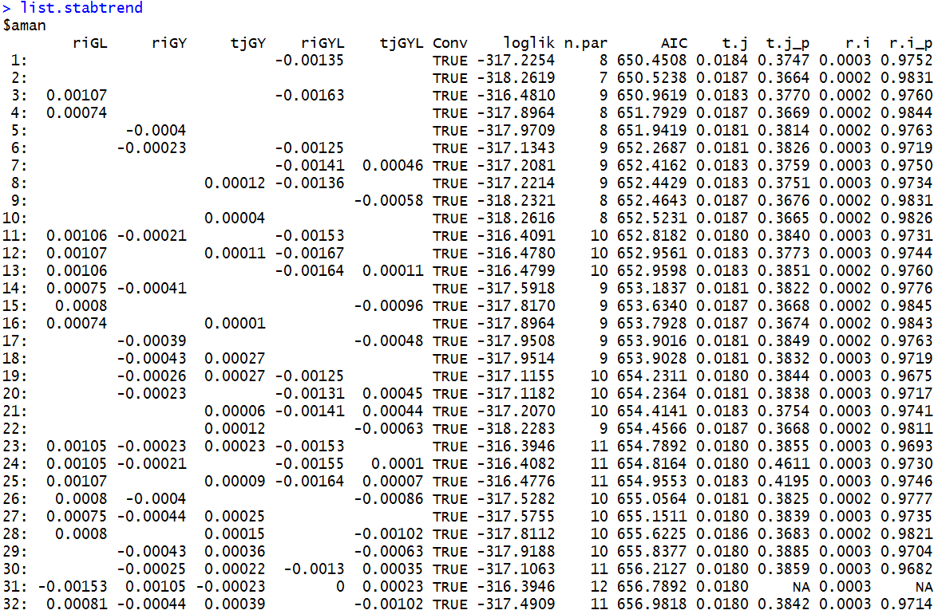
Genetic gain assessment
R-Code:
„02 genetic gain“

Slide 29
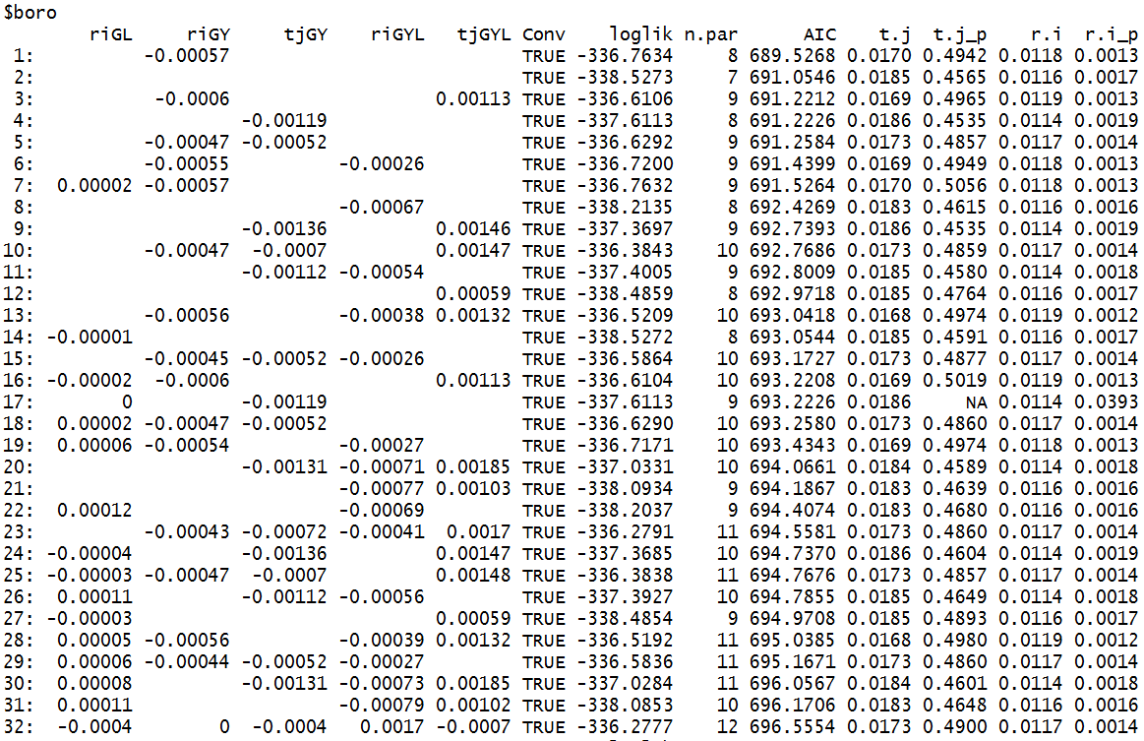
Genetic gain assessment
R-Code:
„02 genetic gain“

Slide 30
Summary: Genetic gain assessment

Slide 31
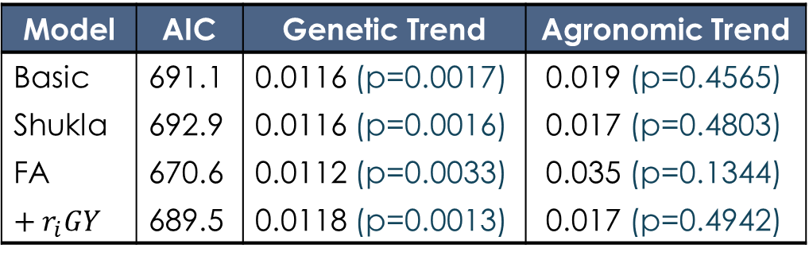
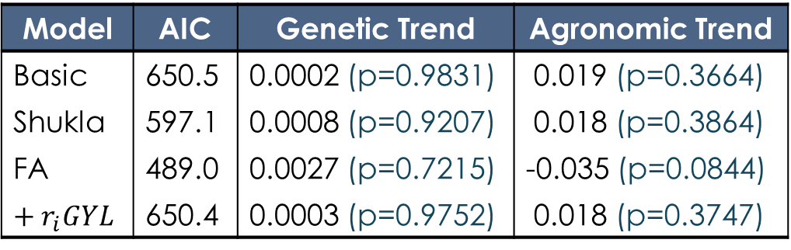
Summary: Genetic gain assessment
aman
Model | AIC | Genetic Trend | Agronomic Trend
Basic | 650.5 | 0.0002 (p=0.9831) | 0.019 (p=0.3664)
Shukla | 597.1 | 0.0008 (p=0.9207) | 0.018 (p=0.3864)
FA | 489.0 | 0.0027 (p=0.7215) | -0.035 (p=0.0844)
$$+ r_{i}GYL$$ | 650.4 | 0.0003 (p=0.9752) | 0.018 (p=0.3747)
boro
Model | AIC | Genetic Trend | Agronomic Trend
Basic | 691.1 | 0.0116 (p=0.0017) | 0.019 (p=0.4565)
Shukla | 692.9 | 0.0116 (p=0.0016) | 0.017 (p=0.4803)
FA | 670.6 | 0.0112 (p=0.0033) | 0.035 (p=0.1344)
$$+ r_{i}GY$$ | 689.5 | 0.0118 (p=0.0013) | 0.017 (p=0.4942)

